Slide 1



THE WEST VIRGINIA
LEGISLATURE
How Laws Are Made

Slide 2
Who makes the rules?
Ask students to give ideas!
  At Home - Parents
  At Home - Grandparents
  At School - Teachers
  At School - Principal
  In the State and In the Country - Lawmakers

Slide 3
Why are there rules?
Ask students to give ideas!
  Safety and protection
  Guidance
  Fairness and Respect
  Kindness
Rules are made by individuals or groups of people; laws are made by the government.

Slide 4




The Three Branches
The State Government is split into three equal branches, just as the federal government.
Executive Branch:
Enforces laws
Legislative Branch:
Makes laws
Judicial Branch:
Interprets laws
This is called checks and balances.

Slide 5
The Executive Branch
The Governor is the leader of the state executive branch.
  Makes sure laws (rules) are followed
  Works with federal government to get help for the state
  Provides money to groups who are working on projects

Slide 6

The Judicial Branch
The Courts make sure laws follow the Constitution.
  Protects the rights of people
  Explain laws
  Settling legal argument
  Punishing those who break the law
  Determine guilt

Slide 7

The Legislative Branch
The Senate and the House of Delegates
  Make the laws
  Chosen by citizens of their district
  Set agendas
  Writes and votes on bills to create new laws
  Makes the state budget

Slide 8




The Legislative Process
Or how a bill becomes a law!
The Committee discusses and votes on bill.
Someone has an idea;
a bill is wrote.
The bill is presented to the committee.

Slide 9

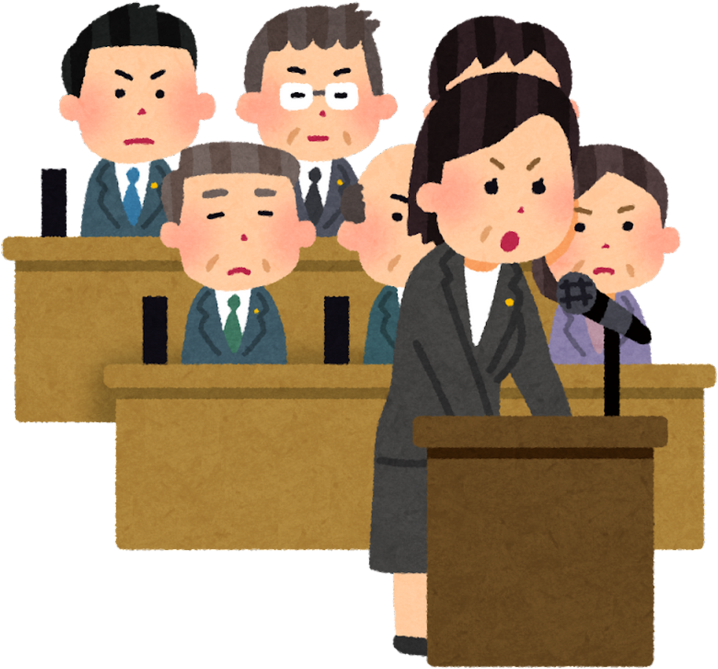


The Legislative Process
Or how a bill becomes a law!
The entire chamber hears is presented the bill.
On third time. the bill is up for vote, the chamber votes to send the bill to the other chamber.
The bill is read three separate times on three different days. On second reading, the bill can be changed.

Slide 10


The Legislative Process
Or how a bill becomes a law!
If it passes out of one chamber, it moves to the other.
The entire chamber hears is presented the bill.
The process starts over and it where it is sent to a committee. The committee will discuss and vote on the bill.

Slide 11

The Legislative Process
The Legislature may vote to override a veto and
the bill becomes law without the Governor’s approval.
Or how a bill becomes a law!
On third time. the bill is up for vote, the chamber votes to send the bill to complete action or send a changed bill back for the other chamber to complete action.
The bill is read three separate times on three different days. On second reading, the bill can be changed.
Once the bill completes legislative action, it moves to the Governor for a signature to become law or veto.

Slide 12
How to be a part of the process?
Several Divisions work behind the scenes to make the process work.
  Find and Contact your lawmaker
    https://www.wvlegislature.gov/index.cfm
    https://joint.wvlegislature.gov/lawmaker-search/
  When you’re 18, VOTE!
  Page for your delegate or senator during session.
  Invite your lawmaker to speak at school.
  Follow on social media to keep up with action: @wvlegislaure, @wvhouse, @wvsenate on X and West Virginia Legislature on Facebook

