Slide 1



THE WEST VIRGINIA
LEGISLATURE
How State Government Works and The Legislative Process

Slide 2
Why Do We Need a Government?
Government helps to make laws, keep order, and protect citizens.
  Laws keep things fair and safe.
  The government provides services like schools, roads, police, and other public services.
  Leaders are elected or appointed to make decisions for the people.
To understand the Legislative Process, one should first understand the three branches of government.

Slide 3




The Three Branches
The State Government is split into three branches, just as the federal government.
Executive Branch:
Enforces laws
Legislative Branch:
Makes laws
Judicial Branch:
Interprets laws

Slide 4
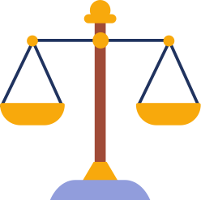
Checks and Balances
Checks and balances of the three branches keep power fair.
  No one branch is too powerful.
  Each branch can check the others.
  Example: The Legislature makes laws, the Governor enforces them, and the Courts review them.

Slide 5
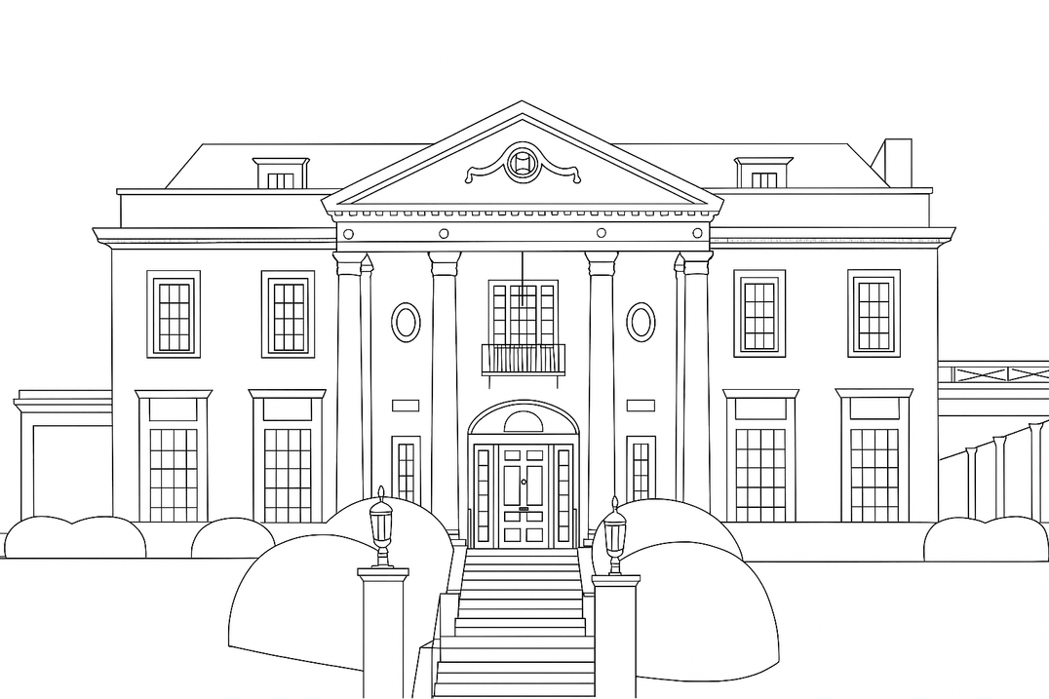
The Executive Branch
The Governor is the leader of the state executive branch.
  The Appointed Cabinet and Elected Board of Public Works help the Governor.
  The Governor serves a 4-year term and can be elected twice.
  The Senate President serves as Lt. Governor.

Slide 6
What Does the Executive Branch Do?
The Governor makes sure laws are followed.
  Signs or vetoes laws made by Legislature
  Declares emergencies
  Provides funds from discretionary spending
  Works with federal government to acquire funding
  Works with Cabinet: Secretary of State, Attorney General, State Auditor, State Treasurer, the Commissioner of Agriculture, and other department secretaries

Slide 7
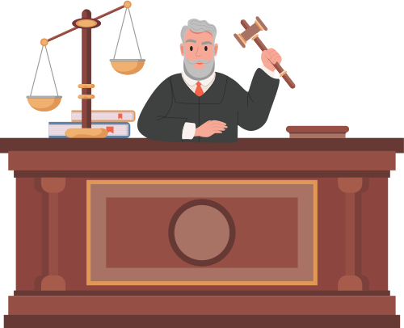
The Judicial Branch
The courts make sure laws follow the Constitution.
  The Supreme Court is the highest court in West Virginia; supervises the lower courts.
  There are 5 justices who serve for 12 years.
  The Chief Justice changes each year
  They decide if laws are fair and constitutional.

Slide 8

What Does the Judical Branch Do?
The Courts protect the rights of the people
  Interpreting state laws
  Settling legal disputes
  Punishing violators of the law
  Hearing civil cases
  Protecting individual rights
  Determine guilt

Slide 9

The Legislative Branch
The West Virginia Legislature makes the laws for the state.
  Made up of two parts: Senate and House of Delegates
  Senate: 2 per district (34 total); elected for four year terms, elections for half the body every two years
  House of Delegates: 1 per district (100 total); elected for two year terms; whole body elections every two years

Slide 10

What Does the Legislative Branch Do?
The Legislature makes laws that affect everyone.
  Represents citizens of their district
  Set agendas
  Work with key players in policy making
  Writes and votes on bills to create new laws
  Approves the state budget

Slide 11




The Legislative Process
Or how a bill becomes a law!
The committee considers the bill by hearing presentations and debating. a vote is take to move the bill to the full chamber.
Someone has an idea;
a bill is drafted.
The bill is introduced and assigned to a committee in the House or the Senate.

Slide 12

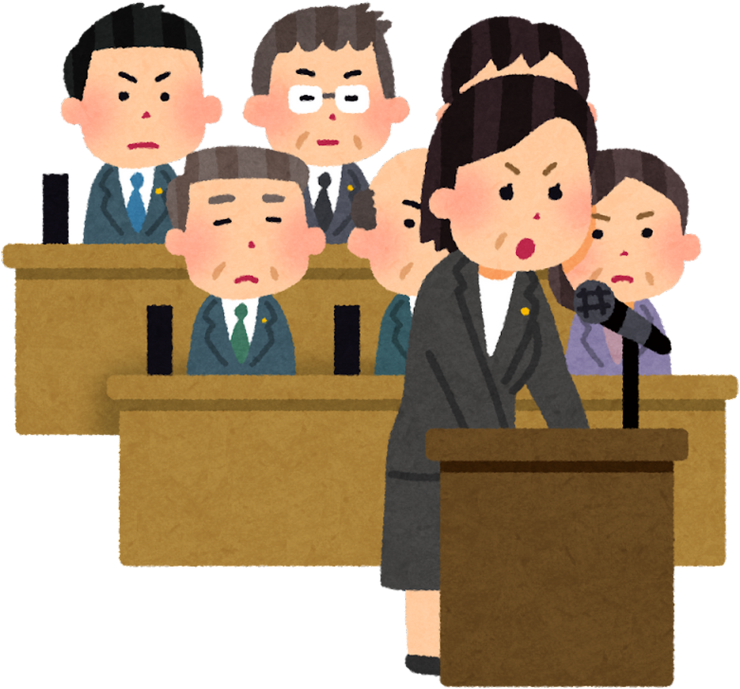


The Legislative Process
Or how a bill becomes a law!
If the bill passes out of committee, it moves to the full chamber.
On third reading the bill is up for passage, the chamber votes to move the bill to the other chamber.
The bill is read three separate times on three different days. On second reading, the bill can be amended.

Slide 13


The Legislative Process
Or how a bill becomes a law!
If it passes out of one chamber, it moves to the other.
If the bill passes out of committee, it moves to the full chamber.
The process repeats where it is assigned to a committee. After consideration, the bill is voted on to determine if it’ll move to the full chamber.

Slide 14

The Legislative Process
The Legislature may vote to override a veto and
the bill becomes law without the Governor’s approval.
Or how a bill becomes a law!
On third reading the bill is up for passage, the chamber votes to complete action or send an amended bill back for the other chamber to complete action.
The bill is read three separate times on three different days. On second reading, the bill can be amended.
Once the bill completes legislative action, it moves to the Governor for a signature to become law or veto.

Slide 15
The Legislative Process
Several Divisions work behind the scenes to make the process work.
  House Staff
    Leadership Staff and Committee Staff work to craft and amend legislation for the House.
  Senate Staff
    Leadership Staff and Committee Staff work to craft and amend legislation for the Senate.
  Joint Committee Staff
    Several Divisions work with both the House and the Senate to serve support the staffs of both chambers, along with the members and the public of West Virginia.

Slide 16
The Legislative Process
While session is only 60 days, work on legislation happens year round.
  Interim meetings allow for research to be presented and discussion with stakeholders outside of session.
  Staff conducts research on best practices, new regulations, new processes, etc. to determine if any changes are needed in the state.
  Lawmakers meet with constituents to determine concerns of their districts.

Slide 17
How to be a part of the process?
Several Divisions work behind the scenes to make the process work.
  Find and Contact your lawmaker
    https://www.wvlegislature.gov/index.cfm
    https://joint.wvlegislature.gov/lawmaker-search/
  If you’re 18, VOTE!
  Page for your delegate or senator during session.
  Invite your lawmaker to speak at school.
  Follow on social media to keep up with action: @wvlegislaure, @wvhouse, @wvsenate on X and West Virginia Legislature on Facebook

