Slide 1
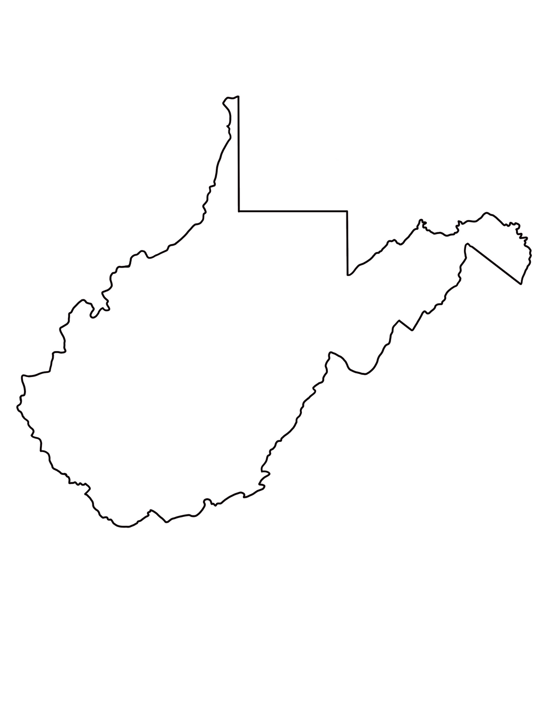



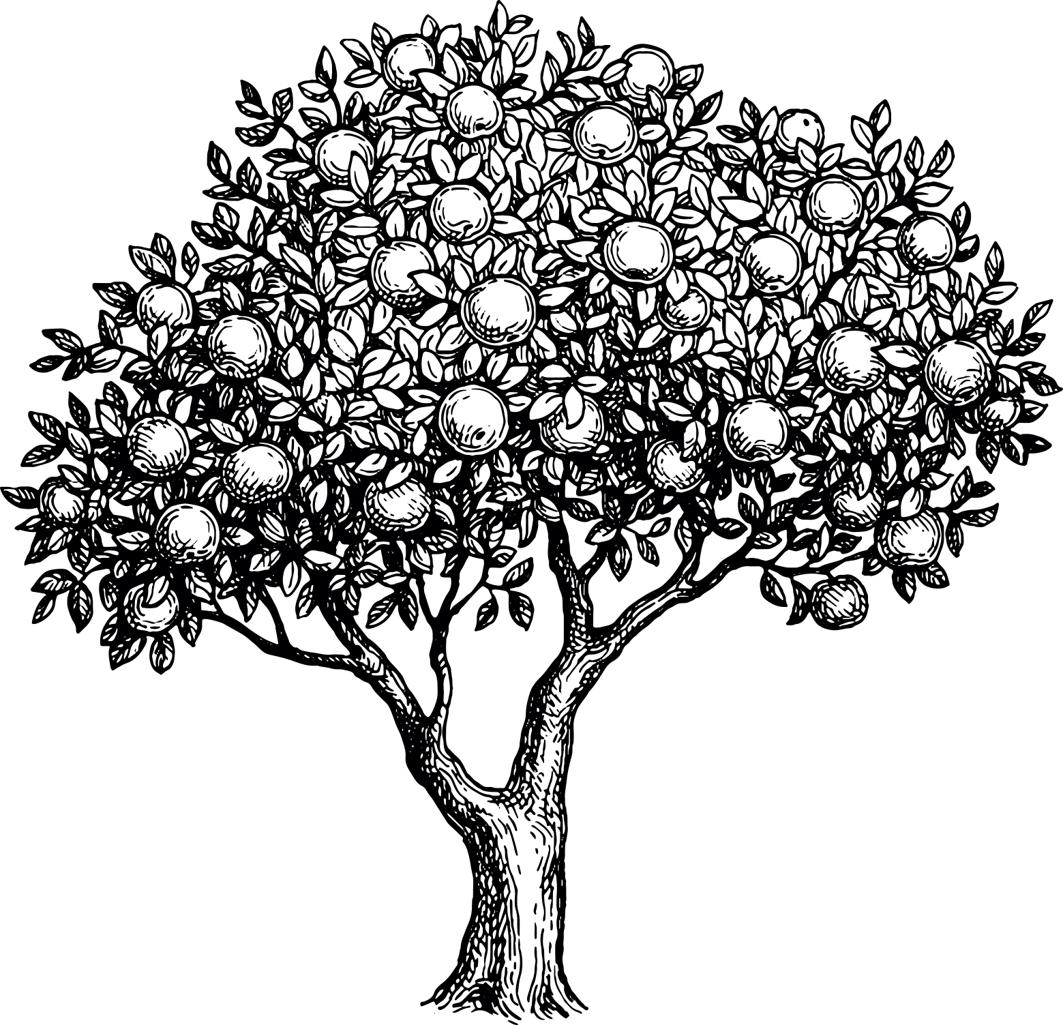



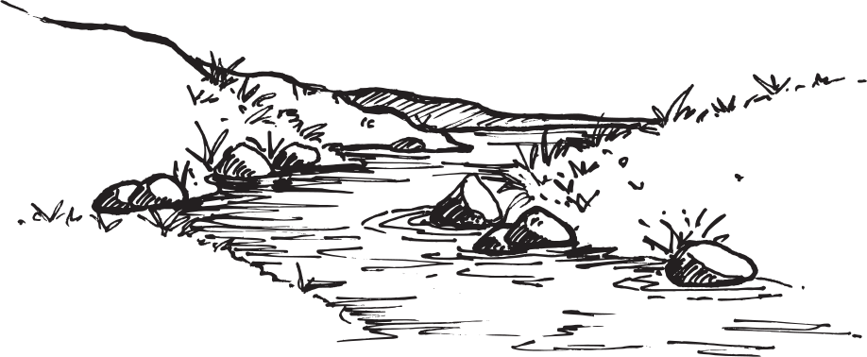





West Virginia
State Symbols

Slide 2
What is a symbol?
SYMBOL
/’ simb( )l/
e
noun
  : an act, sound, or object having cultural significance and the capacity to excite or objectify a response
  : something that stands for or suggests something else by reason of relationship, association, convention, or accidental resemblance
  : an authoritative summary of faith or doctrine : creed
  : an arbitrary or conventional sign used in writing or printing relating to a particular field to represent operations, quantities, elements, relations, or qualities

Slide 3
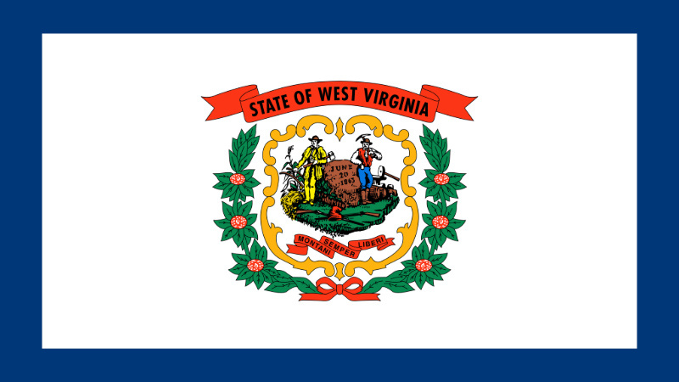
State Flag
The West Virginia state flag was officially adopted by the Legislature on March 7, 1929 through Senate Joint Resolution 18.
The design features West Virginia's coat-of-arms emblazoned in proper colors at the center of a pure white field. A red banner that reads, "State of West Virginia" appears above the coat-of-arms and another red banner bears the state motto toward the bottom. Rhododendron maximums in proper colors are wreathed around the coat-of-arms. The pure white field is bordered on all four sides by a strip of blue.
Per Senate Joint Resolution No. 18, "the proportions of the flag of the State of West Virginia shall be the same as the United States ensign," and when the state flag is used for parade purposes, all sides except for the staff side, must be trimmed with gold fringe. If the state flag of West Virginia is being used ceremoniously with the United States ensign, it must be trimmed and mounted similarly to the national flag in reference to fringe, cord, tassels, and mounting.
FUN FACT: Although several regimental or battle flags were authorized by the state, an official, unified design for the state flag was not addressed until the early twentieth century.

Slide 4
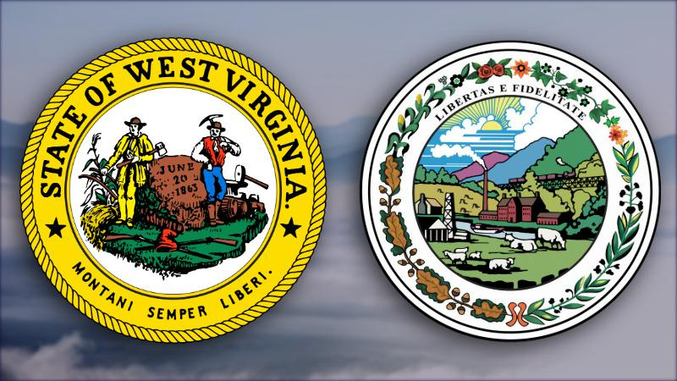
State Seal: The Great Seal
The Great Seal of West Virginia was designed by Joseph H. Diss Debar of Doddridge County and symbolizes the principal pursuits and resources of West Virginia. The design features a farmer and miner standing on either side of a large, ivy-covered stone bearing the date of West Virginia's admission to the Union. In front of the stone, a Phyrgian cap, or "Cap of Liberty," rests atop two hunters' rifles.
The words, "State of West Virginia" and the Latin motto, "Montani Semper Liberi" are featured at the top and bottom respectively on the front (obverse) side of the seal.
Although it is not commonly used, the reverse side serves as the Governor's official seal. Its design depicts laurel and oak leaves, a log farmhouse, hills, factories, and boats.
FUN FACT: The Secretary of State serves as the official "keeper of the seal" and controls its use for any purpose other than official state business.

Slide 5
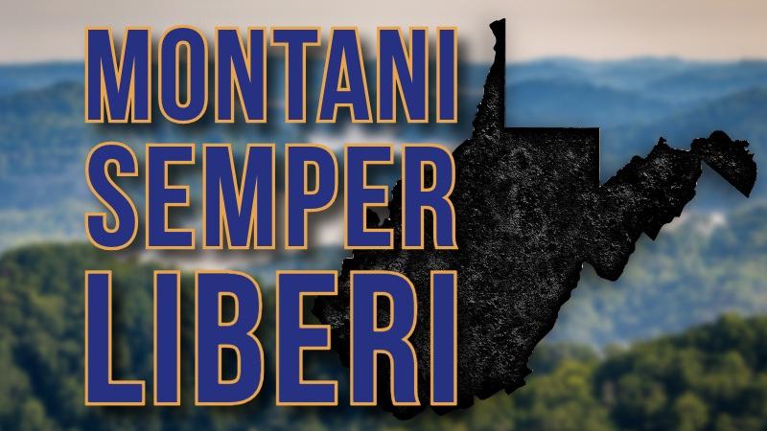
State Motto
The Latin term, "Montani Semper Liberi," which translates in English as "Mountaineers are always free," is the West Virginia state motto.
The first West Virginia legislature adopted the motto on September 26, 1863. The joint committee on the state seal incorporated the motto on the front or obverse side of the new state seal, below the image of rock, miner, and farmer.
According to a 1906 report by State Archivist Virgil A. Lewis, the motto was suggested by Joseph H. Diss Debar (of Doddridge County).
FUN FACT: The Latin phrase had been long used by Swiss mountaineers to express their independence of spirit.

Slide 6
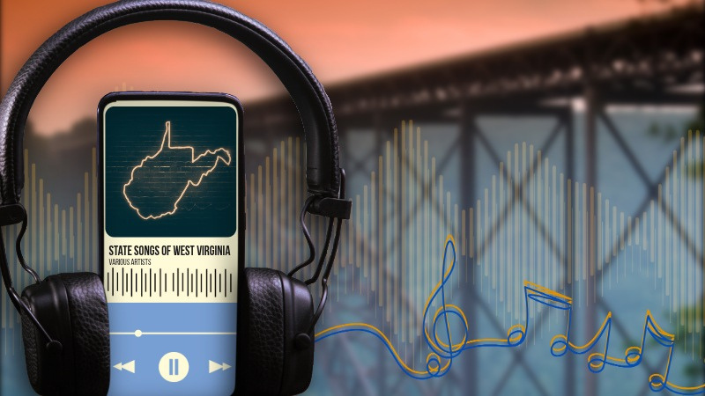
State Song
West Virginia has four official state songs celebrating the beauty and spirit of the Mountain State. Each song ranks equally in official status.
"The West Virginia Hills", "This Is My West Virginia", "West Virginia, My Home Sweet Home", "Take Me Home, Country Roads"
West Virginia, My Home Sweet Home, composed by Wheeling-native Colonel Julian G. Hearne, Jr, was declared to be the state's first official state song on March 3, 1947 with Senate Concurrent Resolution No. 11.
However, without knowing that a state song had already been designated, An edited version of The West Virginia Hills, with original words by Ellen King and music by H.E. Engle was declared to be the official state song in 1961 through Senate Concurrent Resolution No. 5.
In celebration of the state's Centennial, Charleston musician Iris Bell's This Is My West Virginia was named the state's official Centennial Song in 1963.
To reduce and eliminate the confusion surrounding the state's official songs, the Legislature adopted House Concurrent Resolution No. 19 on February 28, 1963, declaring all three as official state songs.
On March 8, 2014, the Legislature adopted House Concurrent Resolution No. 40, which designated Take Me Home, Country Roads written by John Denver, Taffy Nivert, and Bill Danoff and initially recorded by John Denver, as an additional official state song.
FUN FACT: The West Virginia Hills is the oldest of the four state songs. The four-verse poem was originally published in September 1885 in the Glenville Crescent newspaper and credited to Ellen Ruddell King.

Slide 7
State Colors
The official colors of West Virginia, known as Old Gold and Blue, were designated as the state colors by Senate Concurrent Resolution No. 20, which was adopted by the Legislature on March 8, 1963.
FUN FACT: Before their official status as the state colors of West Virginia, gold and blue were often used by the state in ceremonies since they are also the official colors of West Virginia University.

Slide 8
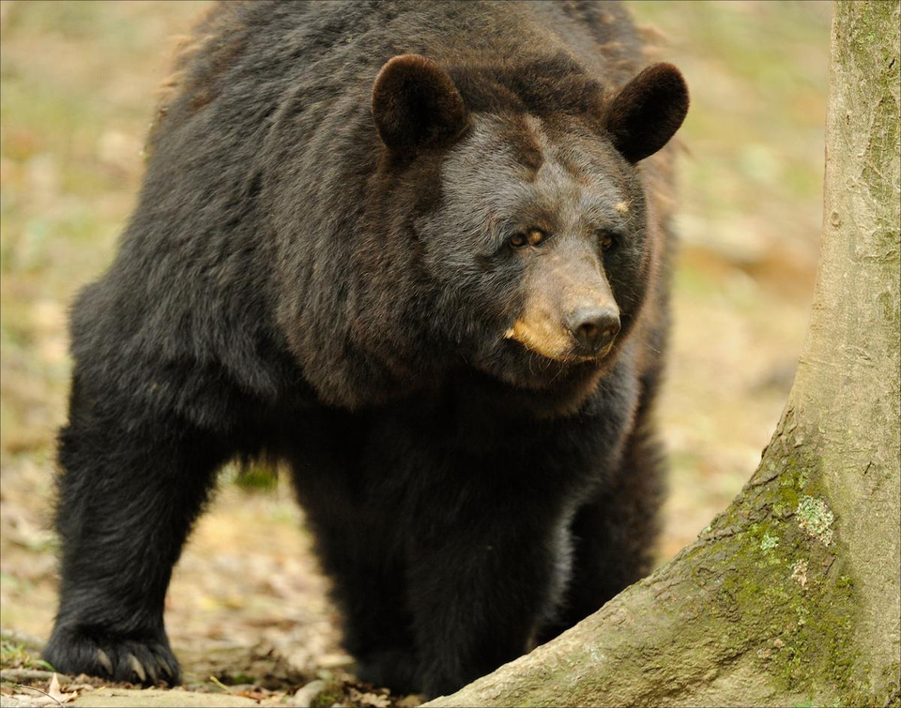
State Animal
The Black bear (Ursus americanus) was selected by West Virginia students, teachers, and sportsmen as the official state animal after a poll was conducted by the Division of Natural Resources from 1954-1955.
Despite being commonly known as "black bears," the coloring of these bears is actually a deep tint of brown! In West Virginia, the blond and cinnamon color variations found in western states are absent. Our bears are deep brown/black, with brown muzzles.
Black bears are generally 6 feet in length and about 3 feet high at the shoulder. Adult males usually weigh between 150 and 450 pounds, while females weigh between 100 and 300 pounds.
The Legislature's approval of House Concurrent Resolution No. 6 in 1973 officially approved the black bear as the state animal of West Virginia.
FUN FACT: Black bears are the only species of bear found in West Virginia. The bear population in West Virginia is estimated to be between 12,000 and 14,000.

Slide 9
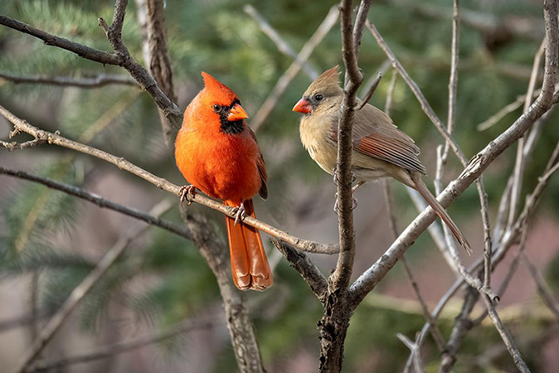
State Bird
West Virginia public school students and various civic organizations voted to select the state bird of West Virginia. The Northern Red Cardinal (Cardinalis cardinalis) won by more than 11,000 votes.
It was chosen for the male's brilliant red coloration and crest and the lovely, although more subtle colors of the female, its statewide distribution, the beautiful, cheery song heard from early spring into summer, and its propensity to live near our dwellings and visit backyard bird feeders.
The West Virginia Legislature officially adopted the cardinal as the state bird on March 7, 1949.
The Northern Red Cardinal eat insets, fruit, and seeds. It builds its nest of twigs, vines, leaves, and grass near the ground, in shrubs, or small trees. The female lays 2 to 5 eggs and sits on them for 12 to 13 days. The hatchlings leave the nest after 10 to 11 days.
FUN FACT: Only male cardinals feature the iconic rich, scarlet plumage and black mask around their beaks. Female and young cardinals are less brilliantly colored, though you can still spot tinges of the distinctive red coloring male cardinals are known for.

Slide 10
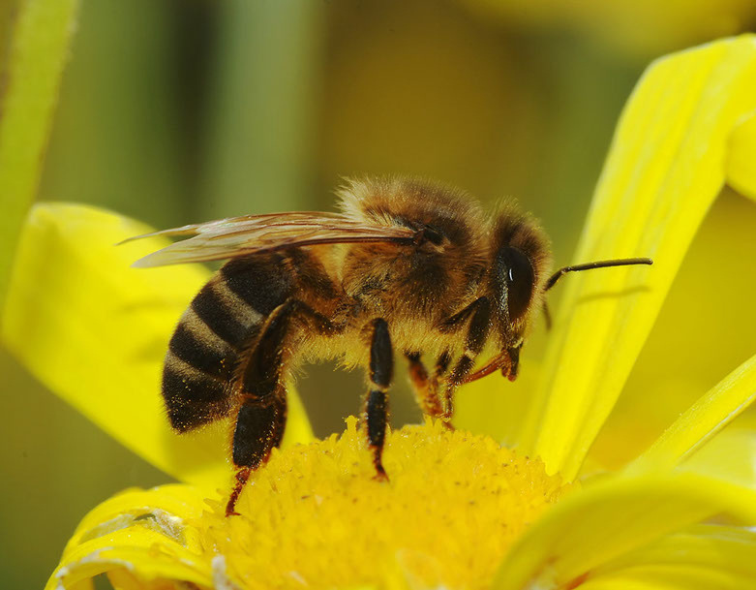
State Insect
The honey bee (Apis mellifera) became the official state insect of West Virginia through the Legislature's adoption of Senate Concurrent Resolution No. 9 on March 7, 2002.
The honey bee, which has six legs, four wings, and a coloring that ranges from dark yellow to gold. Three dark bands are featured on its abdomen. The honey bee produces a flavorful honey and also pollinates many of the state's important crops including fruits, vegetables, and grasses.
The three casts in each hive: queen bees, worker bees, and drone bees. Each colony has one queen bee, she has a long extended abdomen and lays eggs. The worker bees make up most of the colonies population, which are undeveloped females. Their duties change with age. Then drone bees are the largest bees in the colony and has one purpose, which is to mate with the queen. He will then die.
FUN FACT: The honey bee produces more benefits to West Virginia's economy than any other insect. A majority of the state’s honey comes from Locust, Tulip Poplar, and Basswood blossom, although other crops can be used to produce honey.

Slide 11

State Butterfly
The monarch butterfly (Danaus plexippus) was designated as the official state butterfly of West Virginia when Senate Concurrent Resolution No. 11 was adopted by the Legislature on March 1, 1995.
The orange and black insect dines on milkweed as a caterpillar and sips nectar from flowers as a butterfly. These beautiful butterflies can be found throughout the state. At the end of summer, monarch butterflies migrate south to Mexico.
The monarch butterfly is proposed as a threatened species.
FUN FACT: The butterflies that you see in the springtime are the great grandchildren of the butterflies that lived in Mexico during the winter.

Slide 12
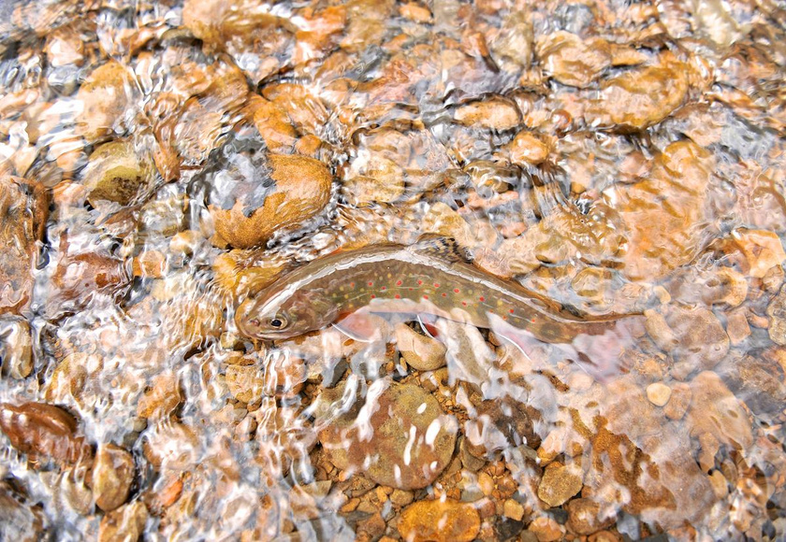
State Fish
The brook trout (Salvelinus fontinalis), which thrives in West Virginia's small, cold, spring-fed mountain streams, became the official state fish in 1973. In fact, the olive-colored fish is the Mountain State's only native species of trout. The light-colored edges of its lower fins help to make the fish easily identifiable. Male brook trouts also feature a recognizable reddish belly.
The Legislature officially recognized it as the state fish with House Concurrent Resolution No. 6, which was adopted during the Regular Session in 1973.
Many of the headwater streams of the Cheat, Greenbrier, Elk, Potomac, and Tygart rivers contain good brook trout populations. The longest brook trout was caught in the Lost River in 1981 and measured 23.5 inches, and the heaviest was 7.64 pounds, caught in Shavers Fork in 2004.
The brook trout can be distinguished from both the rainbow and brown trout by light twisting lines across the back instead of brown or black spots, and the milky-white first ray of pectoral, pelvic, and anal fins
The best time to fish for brook trout is in late April or May when the waters warm a little and the first good hatches of mayflies and other insects appear.
FUN FACT: Brook trout are also known as specks, brook char, and speckled trout.

Slide 13
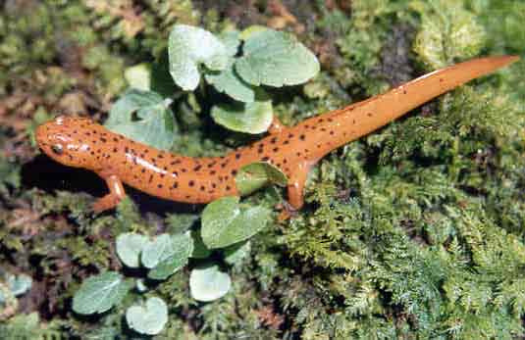
State Amphibian
The Northern red salamander (Pseudotriton ruber) was named the official state amphibian on March 12, 2015 when the Legislature adopted House Concurrent Resolution No. 31.
The resolution was proposed by eighth grade students taking the West Virginia Studies class at Romney Middle School. They proposed that the color pattern of the amphibian showcases the colorful fall foliage of the state—especially that of the Sugar Maple (the state tree of West Virginia)—with the peppered black dots representing the coal mines that dot the region. The five toes on each back foot were declared to represent the state's fifty-five counties and the four toes on each front foot to represent the state's eight major rivers.
The salamanders feed on insets, worms, spiders, and occasionally smaller salamanders. They can be found close to springs, streams, and small creeks, as well as in forest areas.
FUN FACT: Northern red salamanders can be found throughout West Virginia.

Slide 14
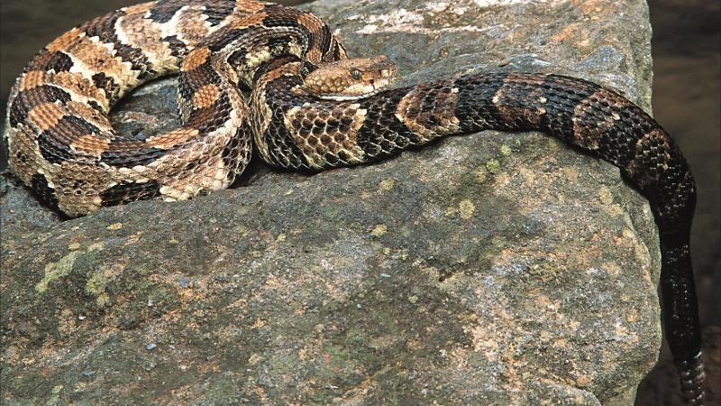
State Reptile
The timber rattlesnake (Crotalus horridus) was designated as the official state reptile in 2008 with the Legislature's adoption of Senate Concurrent Resolution No. 28 on March 8, 2008.
The timber rattlesnake features brown or black chevron-shaped markings down its back that the text of the resolution describes as, "reminiscent of West Virginia's fauna and flora."
Timber rattlesnakes are venomous, though usually docile and found in remote, rocky mountainous sections of the state. It is one of the only two poisonous snakes found in West Virginia, with the other being the copperhead snake. Both timber rattlers and copperheads are pit vipers.
FUN FACT: The timber rattlesnake is the only snake species in the state that has a segmented rattle at the end of its tail.

Slide 15
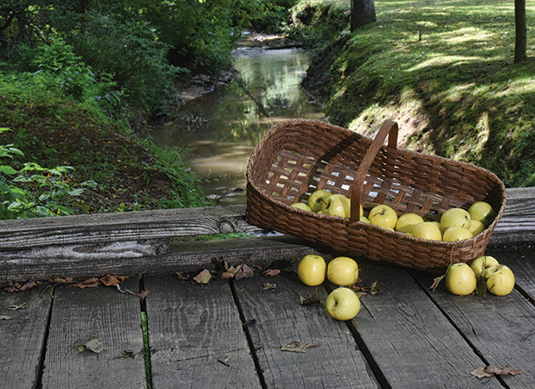
State Fruit
Although West Virginia had named the apple as the official state fruit in 1972, the Legislature's adoption of Senate Concurrent Resolution No. 7 on February 20, 1995 officially specified the Golden Delicious apple as the state fruit of West Virginia.
The Golden Delicious apple (Malus domestica) was discovered by Anderson Mullins in Clay County in 1912 on the Mullins family farm near Porters Creek. Mullins originally called the apple the "Mullins' Yellow Seedling." The mother tree was sold to Stark Brothers Nursery, who popularized the variety as "Golden Delicious."
The Golden Delicious apple is West Virginia's second major contribution to the commercial apple industry with the first being the Grimes Golden apple, which was discovered on the farm of Thomas Grimes near Wellsburg in the early.
FUN FACT: The mother tree of the original Golden Delicious apples bore fruit until it died in the late 1950s. A historical marker for the tree can be found nearby on Route 1.

Slide 16
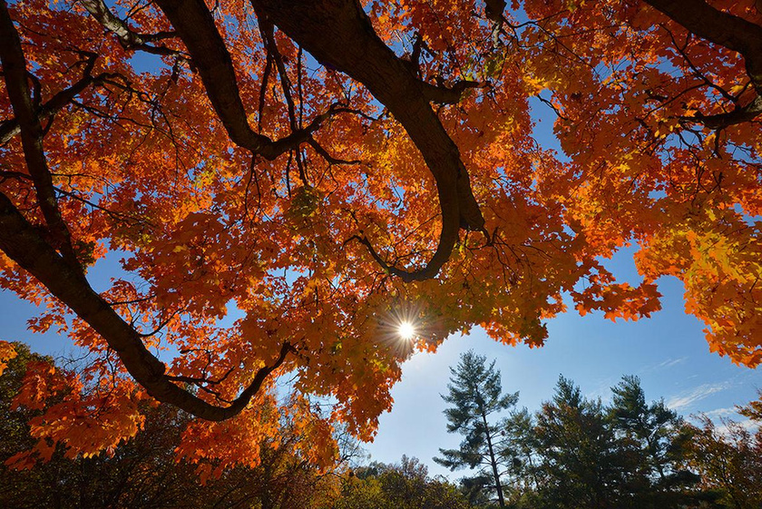
State Tree
Celebrated for its brilliant and beautiful fall foliage, the Sugar Maple (Acer saccharum) was officially designated the state tree of West Virginia through the adoption of House Concurrent Resolution 12 on March 7, 1949. Like the state bird, West Virginia public school students and various civic organizations voted to name the state tree.
Sugar maple tree leaves each feature five lobes. Sugar maples are a valuable source of timber, shading, and maple syrup in the state.
Shade-tolerant sugar maple seedlings more often mature into trees with trunk diameters of 20 to 36 inches and heights of 70 to 100 feet. Watery sap may be collected and boiled down in late winter to yield maple syrup and sugar. The heavy, hard, strong, very resilient wood is ideal for bowling alleys. Other uses include furniture, flooring, toys, and fuel.
FUN FACT: The Sugar Maple can be seen in all 55 counties of West Virginia.

Slide 17
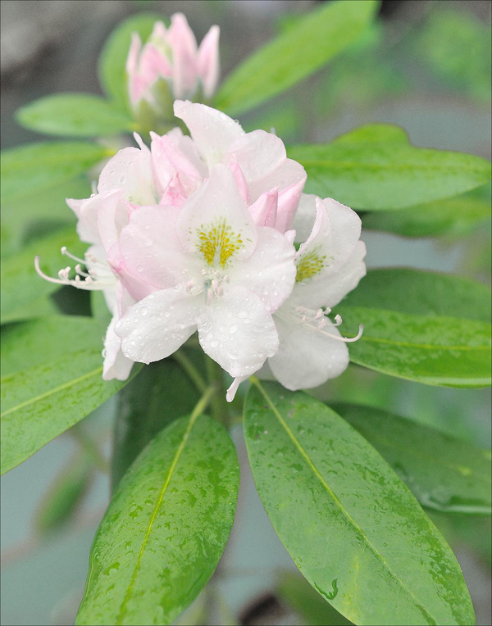
State Flower
The Rhododendron maximum, with its clusters of pink or white flowers mottled with red or yellow flecks and large, evergreen leaves, has been West Virginia's state flower since 1903. House Joint Resolution No. 19 was adopted by the Legislature on January 29, 1903 following recommendation from the Governor and a vote by public school students.
The rhododendron is a shrub belonging to the heath family. It can be found throughout the eastern and midwestern United States. Rhododendron is common in much of West Virginia and produces a spectacular show of natural beauty when in full bloom. Other names for the rhododendron include big laurel, great laurel, white laurel, and rosebay rhododendron.
If the plant has the right soil, moisture, and drainage, it requires little else. The rhododendron is efficient at extracting the nutrients it needs from acid soil. Rhododendrons are often used in landscaping. The hard wood of this plant is used for tool handles and is a favorite of craftspeople for making walking sticks and furniture.
FUN FACT: There are over 800 species of rhododendron throughout the world! The most abundant are the purple (Catawba) rhododendron and rhododendron maximum.

Slide 18
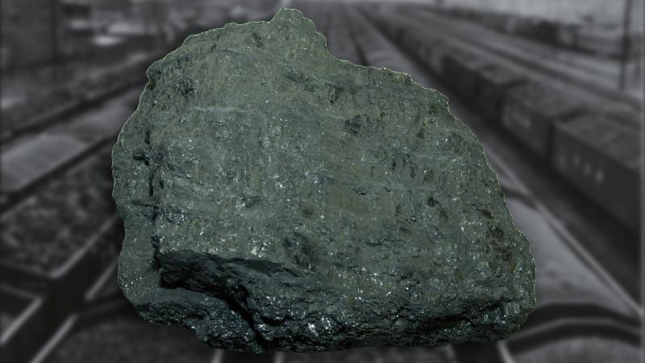
State Rock
The Legislature adopted House Concurrent Resolution No. 37 on April 11, 2009, declaring bituminous coal to be the official state rock of West Virginia.
Coal has been present and noted in the region (present-day West Virginia) since the early days of European exploration. In 1742, European explorer John Peter Salley first discovered the region's coal in the area of Racine. The coal deposit that he observed was located near a tributary of the Kanawha River, which he fittingly named, "Coal River."
Over time, the coal industry evolved into an integral part of the state's economic and social fabric. Coal has been used to produce steel and power generation.
West Virginia's coal is distributed unequally, both geographically and strati-graphically. There are vastly more coal resources in the southern coalfield than the northern coalfield, due to a progressive drying of the climate throughout the Pennsylvanian Period.
FUN FACT: The five counties with highest original coal resources are Logan, Boone, Mingo, Webster, and Nicholas.

Slide 19
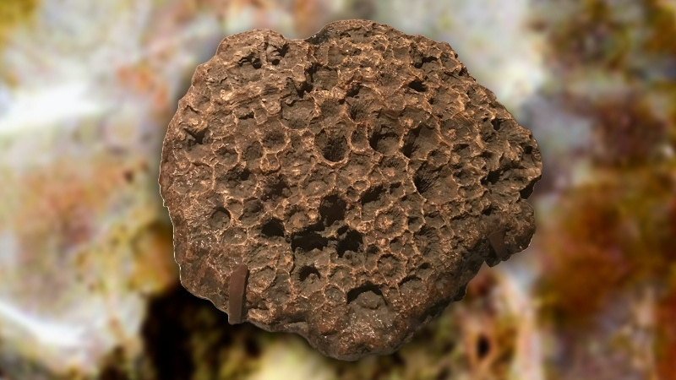
State Gem
Although technically not a gemstone, the adoption of House Concurrent Resolution No. 39 on March 10, 1990 named the state gem as silicified Missippian fossil coral (Lithostrotionella), preserved by chalcedony.
It can be located in the Hillsdale Limestone formation of the Greenbrier Group, found in parts of both Greenbrier and Pocahontas counties in West Virginia, and is often cut and polished for use in jewelry or as a decorative display.
FUN FACT: Lithostrotionella coral lived about 350-325 million years ago in the warm, shallow waters that covered much of North America during the Mississippian Period.

Slide 20

State Fossil
Jefferson's ground sloth (Megalonyx jeffersonii) became the state fossil of West Virginia on March 8, 2008 when the Legislature adopted Senate Concurrent Resolution No. 28.
During the late eighteenth century, the bones of a massive animal were discovered in present-day Monroe County by miners digging saltpeter. The bones were presented to President Thomas Jefferson, who presented the fossil to the American Philosophical Society in 1797. In reference to the size and shape of the limb bones, he coined the animal as Megalonyx, which is Greek for "great claw."
Two years later, the same bones were described and published by Casper Wister, a physician. He described the bones as belonging to a giant extinct ground sloth, a species of ground sloth that measured over eight feet tall and weighed more than 1,000 pounds. Wister credited Jefferson with the discovery and named the animal accordingly in his honor.
Replicas of the Megalonyx jeffersonii are on display at the West Virginia Geological and Economic Survey Museum in Morgantown and at the Interstate 64 welcome center near Lewisburg.
FUN FACT: West Virginia declared its state fossil in an effort to help promote interest in geology, paleontology, and history.

Slide 21
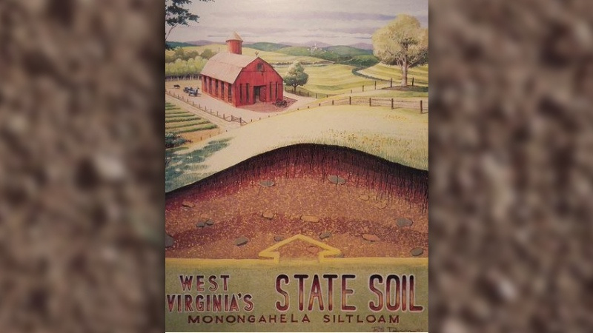
State Soil
Monongahela silt loam was named state soil of West Virginia on April 2, 1997 when the Legislature adopted Senate Concurrent Resolution No. 5. This resolution made West Virginia the twelfth state to declare an official state soil.
Monongahela silt loam is used extensively for crops, hay. pasture, woodland, housing, and prime farmland. It is widespread through the state.
The soil derives largely from sandstone and shale, sedimentary rocks formed millennia ago by the siltation of streams. It occurs particularly on terraces but is also present on slopes of as much as 25 percent grade. The soil is slightly acidic.
FUN FACT: Monongahela silt loam covers more than 100,000 acres in 45 counties.

Slide 22

State Tartan
The adoption of House Concurrent Resolution No. 29 by the Legislature on March 6, 2008 designated the West Virginia Shawl as the official state tartan.
A tartan, which is a woolen plaid cloth, was originally worn to differentiate between Scottish clans and families. The pattern of the official state tartan is based on a previously undiscovered shawl found at the Daughters of the American Revolution Museum in Barboursville, Cabell County and includes colors that most fully represent West Virginia's history, culture, and beauty in a symmetrical design.
Each color of the state tartan's design represents a different aspect of the state:
  Scarlet:The cardinal
  Yellow:Fall colors
  Dark Blue:Mountain rivers and lakes
  Black:The black bear as well as coal and oil
  Green:The rhododendron and mountain meadows
  Azure:The sky
  White:To include all colors of the United States flag
FUN FACT: Many of West Virginia's early settlers included descendants of Celtic people. Several other states have also declared an official state tartan to honor their Celtic ancestry.

Slide 23

State Firearm
The Hall Flintlock Model 1819 was named the official state firearm by the Legislature on April 4, 2013 with the adoption of Senate Concurrent Resolution No. 7.
Originally manufactured in Harpers Ferry by John H. Hall, this model of rifle was adopted into the United States Army in 1819 and was the first breech-loading rifle to be adopted by any nation's military. The firearm is characterized by a block breech that has the ability to be lifted out, allowing the operator to insert the powder and bullet, which offered a faster and simpler way to handle a gun.
The Flintlock Model continued to be used during the U.S. Civil War. This fact alone makes the firearm significant to West Virginia, as the state was born out of that conflict.
FUN FACT: The Hall Flintlock Model 1819 was the first entirely machine-made weapon ever manufactured with interchangeable parts.

Slide 24
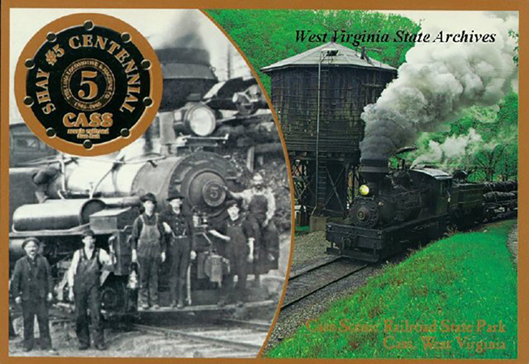
State Locomotive
The Cass Scenic Railroad's Shay No. 5 steam locomotive was designated as the official steam locomotive of West Virginia when the Legislature adopted Senate Concurrent Resolution No. 34 on March 11, 2004.
This turn-of-the-century class C-80 Shay has been toiling up Cheat Mountain since 1905. The legendary Shay No. 5 was built for the Greenbrier and Elk River Railroad by Lima Locomotive Works of Lima, Ohio.
The Shay No. 5 was named as State Locomotive as a tribute to West Virginia's timbering history and as an important historical artifact that serves as a wonderfully preserved example of early twentieth century technology.
FUN FACT: The Shay No. 5 is one of the oldest engines in continuous service on its original line and is the second oldest Shay in existence.

Slide 25
PowerPoint created by the West Virginia Legislative Office of Reference and Information.
Photos and information from West Virginia State Museum Education Page.

